Slide 1
Project Frozen Lake
Group Members
abrar ul Hassan (10970)
Zeeshan Yousuf (10895)
Abdullah Harees (10555)
Ali (10419)

Slide 2
Reinforcement Learning
Introduction
Passive Reinforcement Learning
Active Reinforcement Learning
Applications
Q-learning

Slide 3
Introduction
Supervised Learning:
Example Class
Reinforcement Learning:
…
Situation Reward
Situation Reward

Slide 4
Examples
Playing chess:
Reward comes at end of game
Ping-pong:
Reward on each point scored
Animals:
Hunger and pain - negative reward
food intake – positive reward

Slide 5
Basic Notations
T(s,a,s’) denotes the probability of reaching s’ when using action a in state s; it describes the transition model
R(s) denotes the reward an agent receives in state s
based agents learn an function of states uses it to select actions to maximize the expected outcome.
Finally, reflex agents learn a policy that maps directly from states to actions

Slide 6
Reinforcement Learning
Introduction
Passive Reinforcement Learning
Active Reinforcement Learning
Applications
Summary

Slide 7
Passive Learning
We assume the policy Π is fixed.
In state s we always execute action Π(s)
Rewards are given.

Slide 8
Reinforcement Learning
Introduction
Passive Reinforcement Learning
Active Reinforcement Learning
Applications
Q Learning

Slide 9
Reinforcement Learning
Introduction
Passive Reinforcement Learning
Active Reinforcement Learning
Applications
Q Learning

Slide 10
Active Reinforcement Learning
Now we must decide what actions to take.
Optimal policy: Choose action with
highest value.

Slide 11
Explore vs Exploit
Exploitation: Maximize its reward
vs
Exploration: Maximize long-term
reward

Slide 12
Reinforcement Learning
Introduction
Passive Reinforcement Learning
Temporal Difference Learning
Active Reinforcement Learning
Applications
Q-learning

Slide 13
Applications
Game Playing
Checker playing program by
Arthur Samuel (IBM)
Update rules: change weights by
difference between current states
and backed-up value generating

Slide 14
Q Learning
Q-learning is a model-free, value-based, off-policy algorithm that will find the best series of actions based on the agent's current state. The “Q” stands for quality. Quality represents how valuable the action is in maximizing future rewards.

Slide 15
Q-learing
We will learn in detail how Q-learning works by using the example of a frozen lake. In this environment, the agent must cross the frozen lake from the start to the goal, without falling into the holes. The best strategy is to reach goals by taking the shortest path.

Slide 16
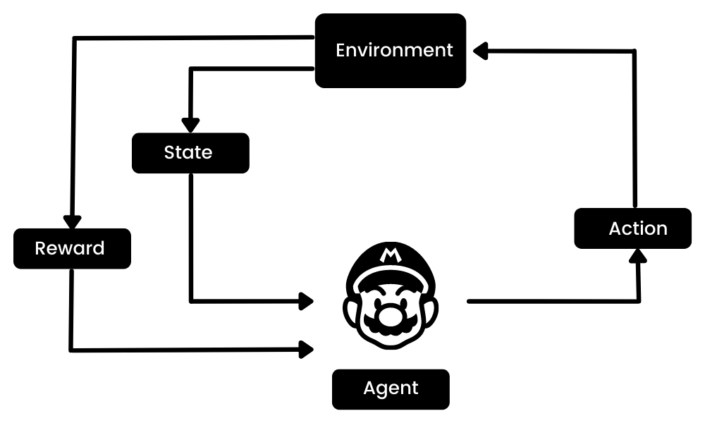
Working Q-learning

